Slide 1
Diseño Objeto-Relacional
Asignatura Bases de Datos
Dra. Angélica Urrutia Sepúlveda
GGR/2000

Slide 2
Contenido
Introducción
El modelo Objeto-Relacional
Creación de tipos de datos
Creación de tablas
Manipulación de objetos
GGR/2000

Slide 3
El Modelo Objeto-Relacional
Modelo de Objetos sobre el modelo relacional
  Object types (Name, attributes, Methods)
  Object_Variable.Method()
GGR/2000

Slide 4
El Modelo Objeto-Relacional
Purchase Order
PONo
OrderDate
ShipDate
getPONo()
sumLineItems()
GGR/2000

Slide 5
El Modelo Objeto-Relacional
Constructor
purchase_order(
1000376,
person ("John Smith","1-800-555-1212"),
NULL )
GGR/2000

Slide 6
El Modelo Objeto-Relacional
Object Table: Es un tipo especial de tabla en la cual cada fila representa un objeto
CREATE TABLE person_table OF person;
INSERT INTO person_table VALUES (
"John Smith","1-800-555-1212" );
CREATE TYPE person AS OBJECT (
name VARCHAR2(30),
manager REF person );
GGR/2000

Slide 7
El Modelo Objeto-Relacional
Row Objects
Columns objects
GGR/2000

Slide 8
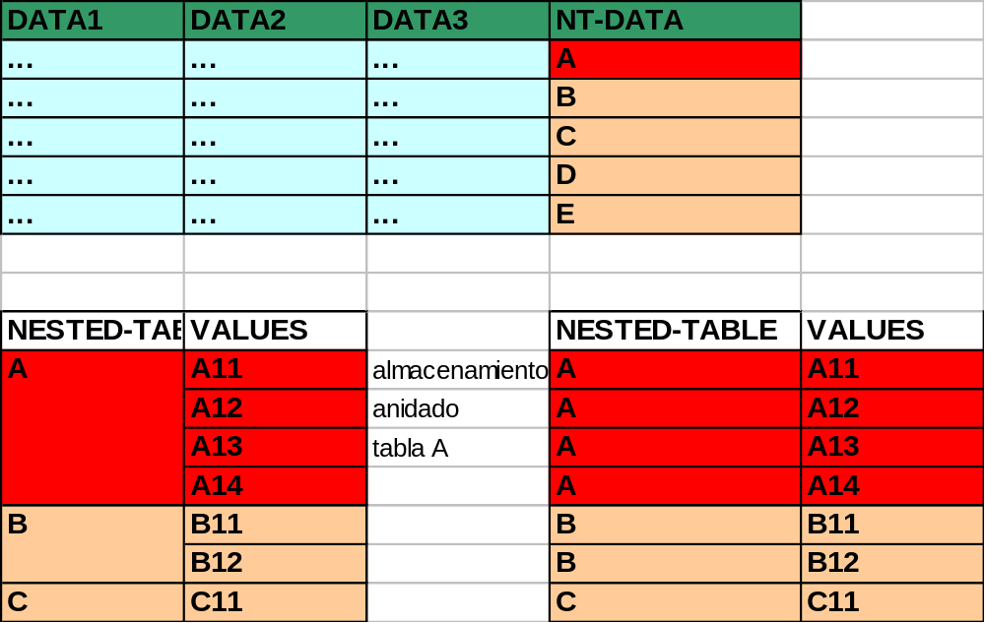
El Modelo Objeto-Relacional

Slide 9
El Modelo Objeto-Relacional
Collections/VARRAYs
CREATE TYPE prices
AS VARRAY(10) OF NUMBER(12,2);
Conjunto Ordenado de elementos
Todos Los elementos son del mismo tipo
Cada elemento tiene un índice
GGR/2000

Slide 10
El Modelo Objeto-Relacional
Collections/Nested Table
CREATE TYPE lineitem_table AS TABLE OF lineitem;
Conjunto no Ordenado de elementos
Todos Los elementos son del mismo tipo
Tiene una sola columna (built-in, Object Type)
NESTED TABLE lineitems STORE AS lineitems_table;
GGR/2000

Slide 11
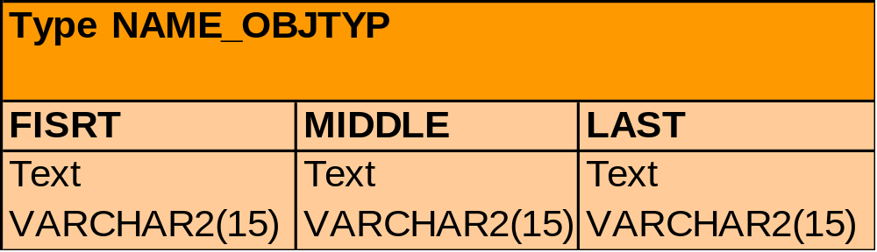
El Modelo Objeto-Relacional
CREATE TYPE name_objtyp AS OBJECT (
first VARCHAR2(15),
middle VARCHAR2(15),
last VARCHAR2(15));

Slide 12
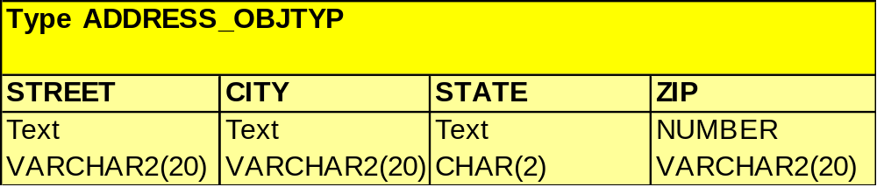
El Modelo Objeto-Relacional
CREATE TYPE address_objtyp AS OBJECT (
street VARCHAR2(200),
city VARCHAR2(200),
state CHAR(2),
zipcode VARCHAR2(20));

Slide 13
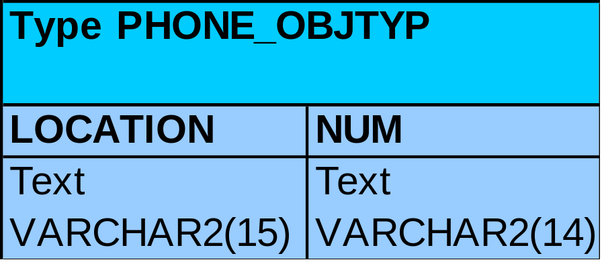
El Modelo Objeto-Relacional
CREATE TYPE phone_objtyp AS OBJECT (
location VARCHAR2(15),
num VARCHAR2(14));

Slide 14
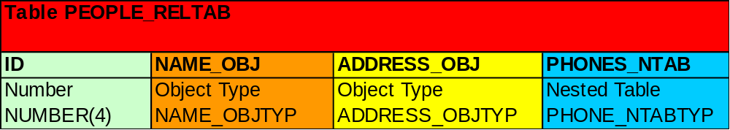
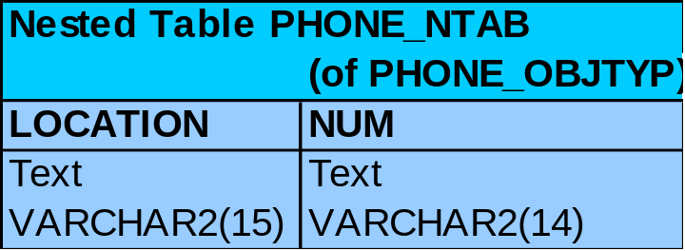
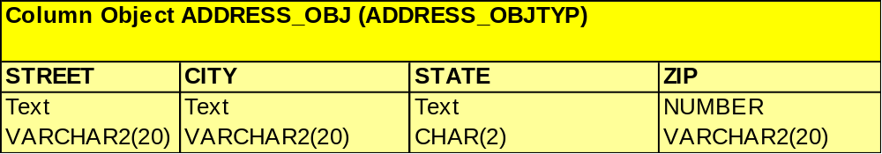
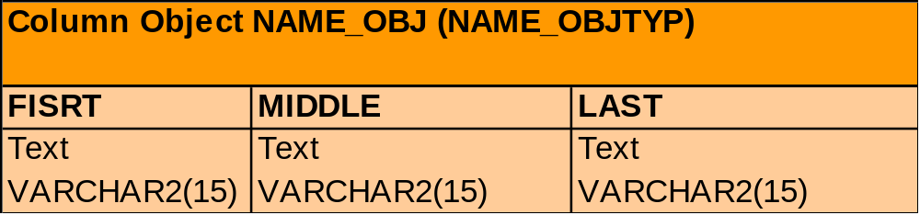

Slide 15
CREATE TYPE phone_ntabtyp AS TABLE OF phone_objtyp;
CREATE TABLE people_reltab (
id NUMBER(4) CONSTRAINT pk_people_reltab PRIMARY KEY,
name_obj name_objtyp,
address_obj address_objtyp,
phones_ntab phone_ntabtyp);

Slide 16
INGRESO DE DATOS A PEOPLE_RELTAB
INSERT INTO people_reltab values (
0001,
name_objtyp( ’john’, ’william’, ’foster’),
address_objtyp(’111 Maple Road’, ’Fairfax’, ’VA’, ’22033’),
phone_ntabtyp(
phone_objtyp(’home’, ’650.331.1222’),
phone_objtyp(’work’, ’650.945.4389’))) ;

Slide 17
CREATE TYPE phone_ntabtyp AS TABLE OF phone_objtyp;
CREATE TABLE people_reltab (
id NUMBER(4) CONSTRAINT pk_people_reltab PRIMARY KEY,
name_obj name_objtyp,
address_obj address_objtyp,
phones_ntab phone_ntabtyp)
NESTED TABLE phones_ntab STORE AS phone_store_ntab;

Slide 18
CREACIÓN DE TABLAS OBJETO
For example, suppose the object type address_objtyp is used to create an object table named address_objtab:
Then, a people_reltab2 table can be created that has the same definition as the people_reltab, except that a REF is used for the address:
CREATE TABLE address_objtab OF address_objtyp ;

Slide 19
CREACIÓN ANIDADA
CREATE TABLE people_reltab2 (
id NUMBER(4) CONSTRAINT pk_people_reltab2 PRIMARY KEY,
name_obj name_objtyp,
address_ref REF address_objtyp SCOPE IS address_objtab,
phones_ntab phone_ntabtyp)
NESTED TABLE phones_ntab STORE AS phone_store_ntab2 ;
Now, an index can be created on the address_ref column: CREATE INDEX address_ref_idx ON people_reltab2 (address_ref) ;

Slide 20
CONSULTAS Objeto-Relacional
SELECT id FROM people_reltab2 p
WHERE p.address_ref.state = 'CA' ;
SELECT p.id FROM people_reltab2 p, address_objtab a
WHERE p.address_ref = ref(a) AND a.state = 'CA' ;
When this query is executed, the address_ref_idx index is used to efficiently evaluate it. Here, address_ref is a scoped REF column that stores references to addresses stored in the address_objtab object table. Oracle implicitly transforms the above query into a query with a join:

Slide 21
CONSULTAS Objeto-Relacional
SELECT p.name_obj, n.num
FROM people_reltab p, TABLE(p.phones_ntab) n ;

Slide 22
UCM
Ejemplo de Modelo Objeto-Relacional
Valores Nulos
CREATE TYPE person AS OBJECT (name VARCHAR2(30),phone VARCHAR2(20) );
CREATE TABLE contacts (contact person, date DATE );
INSERT INTO contacts VALUES (person (NULL, NULL),’24 Jun 1997’);
INSERT INTO contacts VALUES (NULL,’24 Jun 1997’ );
GGR/2000

Slide 23
Ejemplos de Modelo Objeto-Relacional
Example 1 - Tipo definido por el usuario
CREATE OR REPLACE TYPE Address AS OBJECT
( Street VARCHAR2(80),
City VARCHAR2(80),
State CHAR(2),
Zip VARCHAR2(10) );
Example 2 - Tabla Anidada
CREATE OR REPLACE TYPE AddressList AS TABLE OF Address;
GGR/2000

Slide 24
Ejemplos de Modelo Objeto-Relacional
Example 3 - User-Defined VARRAY Type
CREATE OR REPLACE TYPE PhoneList
AS VARRAY(10) OF VARCHAR2(12);
Example 4 - User-Defined Object Type with Embedded Object
CREATE OR REPLACE TYPE Person AS OBJECT
( FirstName VARCHAR2(10),
LastName VARCHAR2(10),
CurAddr Address );
GGR/2000

Slide 25
Ejemplo de Modelo Objeto-Relacional
Example 5 - User-Defined Object Type with REF
CREATE OR REPLACE TYPE Person; // Tipo Incompleto//
CREATE OR REPLACE TYPE Person AS OBJECT
( FirstName VARCHAR2(10),
LastName VARCHAR2(10),
CurAddr Address,
Mom REF Person,
Dad REF Person,
PrevAddrs AddressList,
PhoneNums PhoneList );
GGR/2000

Slide 26
Ejemplo de Modelo Objeto-Relacional
Example 6 - User-Defined Object Type with Methods
CREATE OR REPLACE TYPE Person;
CREATE OR REPLACE TYPE Person AS OBJECT
( FirstName VARCHAR2(10),
LastName VARCHAR2(10),
CurAddr Address,
Mom REF Person,
Dad REF Person,
PrevAddrs AddressList,
PhoneNums PhoneList,
MEMBER FUNCTION FullName RETURN VARCHAR2,
MEMBER PROCEDURE MoveTo (newAddr IN Address),
PRAGMA RESTRICT_REFERENCES (FullName, RNDS, WNDS) );
GGR/2000

Slide 27
Ejemplo de Modelo Objeto-Relacional
Example 6 (continuación)
CREATE OR REPLACE TYPE BODY Person AS
MEMBER FUNCTION FullName RETURN VARCHAR2 IS
BEGIN
RETURN (SELF.FirstName || ' ' || SELF.LastName);
END FullName;
GGR/2000

Slide 28
Ejemplo de Modelo Objeto-Relacional
Example 7 - Creating an Object Table
CREATE TABLE People OF Person
NESTED TABLE PrevAddrs STORE AS PrevAddrTab;
Example 8 - Creating a Table with an Object Column
CREATE TABLE Corporation
( CorpName VARCHAR2(80),
CorpAddr Address,
CorpCEO REF Person SCOPE IS People );
GGR/2000

Slide 29
UCM
Ejemplo de Modelo Objeto-Relacional
Example 9 - Populating the People Table
INSERT INTO People
VALUES ( Person('Mr.', 'Ellison',
Address('1 First Street', 'Orlando', 'FL', '34812'),
Address(Address('2 Second Street', 'Orlando', 'FL', '34812'),
Address('3 Third Street', 'Orlando', 'FL', '34812')),
PhoneList('407-555-1234', '407-555-4321')) );
GGR/2000

Slide 30
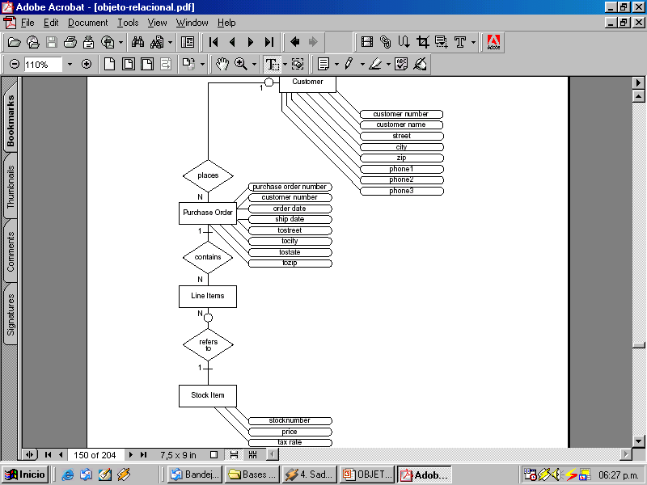

Slide 31
